Slide 1




NEXT GEN EMPLOYABILITY PROGRAM
Creating a future-ready workforce
Team Members
College Name
Student Name : Alvin Roy A
Student ID : 311121104004
Loyola ICAM College Of Engineering and Technology

Slide 2

CAPSTONE PROJECT SHOWCASE
Project Title
Notes Sharing Web Application using Django Framework
Abstract | Problem Statement | Project Overview | Proposed Solution | Technology Used | Modelling & Results | Conclusion

Slide 3
Abstract
The development of a music player web application aims to provide users with a seamless and enjoyable music listening experience directly from their web browsers. This project focuses on creating a user-friendly interface that allows users to search, browse, and play their favorite songs and playlists from an extensive music library. Key features of the application include customizable playlists, shuffle and repeat options, and the ability to create user profiles to save preferences and track listening history. The application will leverage modern web technologies such as HTML, CSS, JavaScript, Django, and APIs to integrate with music streaming services and ensure compatibility across different devices and platforms. Through this project, we aim to deliver a high-quality music player solution that enhances the user's enjoyment and convenience in accessing and enjoying music online.

Slide 4
Problem Statement
Despite the popularity of music streaming services, many users still face challenges when accessing their favorite songs and playlists directly from their web browsers. Existing web-based music players may lack user-friendly interfaces, customization options, or compatibility across different devices and platforms. Additionally, users may encounter limitations in playlist management, search functionality, and personalized recommendations. This project aims to address these issues by developing a robust and intuitive music player web application that offers seamless music streaming, extensive customization features, and compatibility across various devices and platforms. By addressing these pain points, the goal is to provide users with an enhanced and enjoyable music listening experience online.

Slide 5
Project Overview
- Development of a user-friendly music player web application for seamless music streaming.
- Features include intuitive interface, playlist management, playback controls, and robust search functionality.
- Integration with music streaming services or APIs for access to extensive music library.
- Option for user profiles to save preferences and track listening history.
- Ensures compatibility across devices and offers customization features.
- Utilizes HTML, CSS, JavaScript, Django and APIs for development.
- Emphasizes usability, performance, and compatibility.
- Incorporates testing and user feedback for refinement.
- Aims to deliver high-quality music streaming experience online.

Slide 6
Proposed Solution
.
- Develop a modern web interface using HTML, CSS,JavaScript and Django
- Integrate with music streaming services via APIs for a vast music library.
- Include playlist management and playback controls for user convenience.
- Implement robust search functionality and user profiles for customization.
- Ensure compatibility across devices and prioritize usability and performance.
- Gather user feedback for iterative improvements.
- Deliver a high-quality music streaming experience online.

Slide 7


Technology Used
Front-end
Back-end

Slide 8
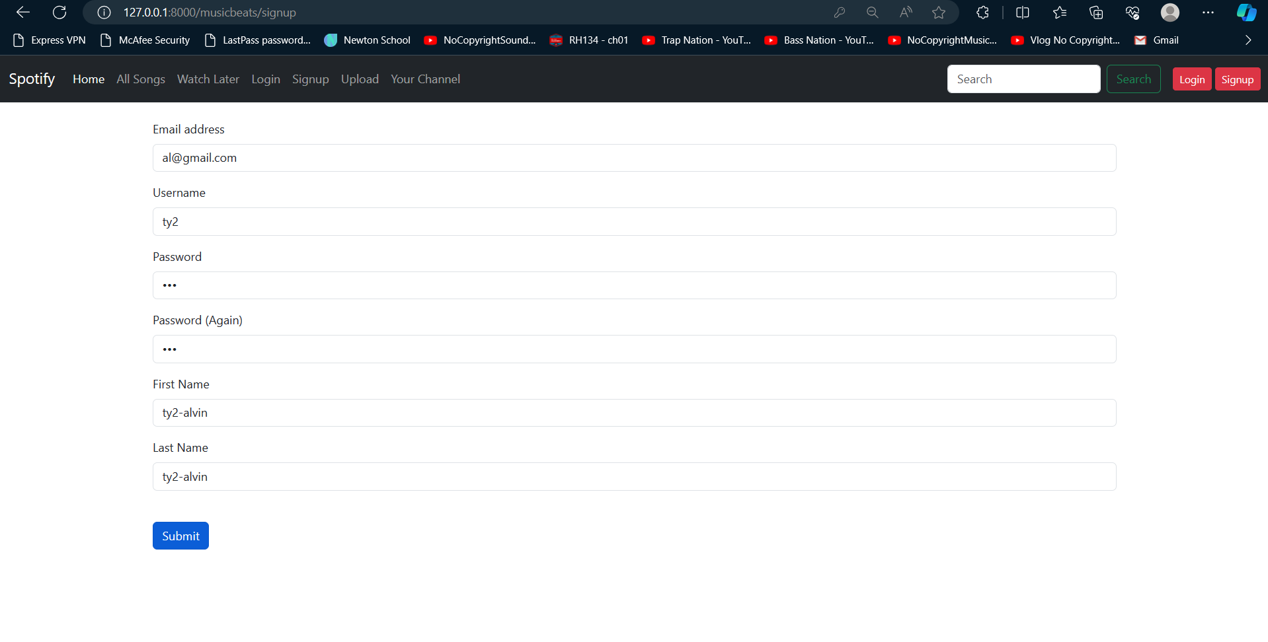
Sign Up

Slide 9
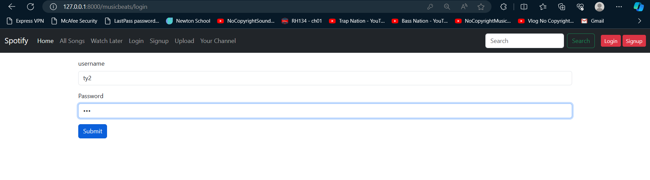
Login

Slide 10
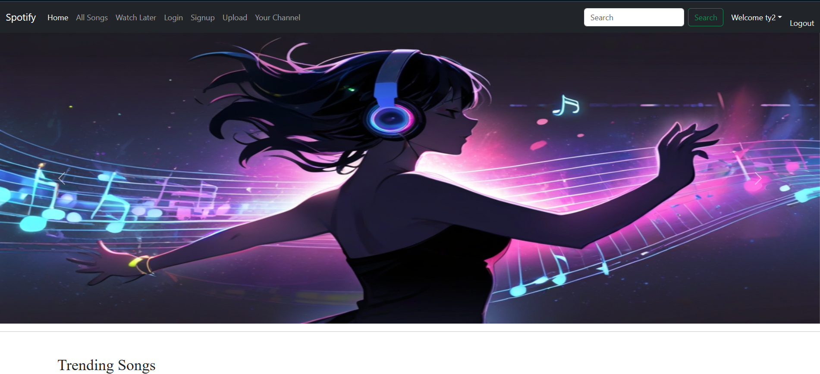
Home Page

Slide 11
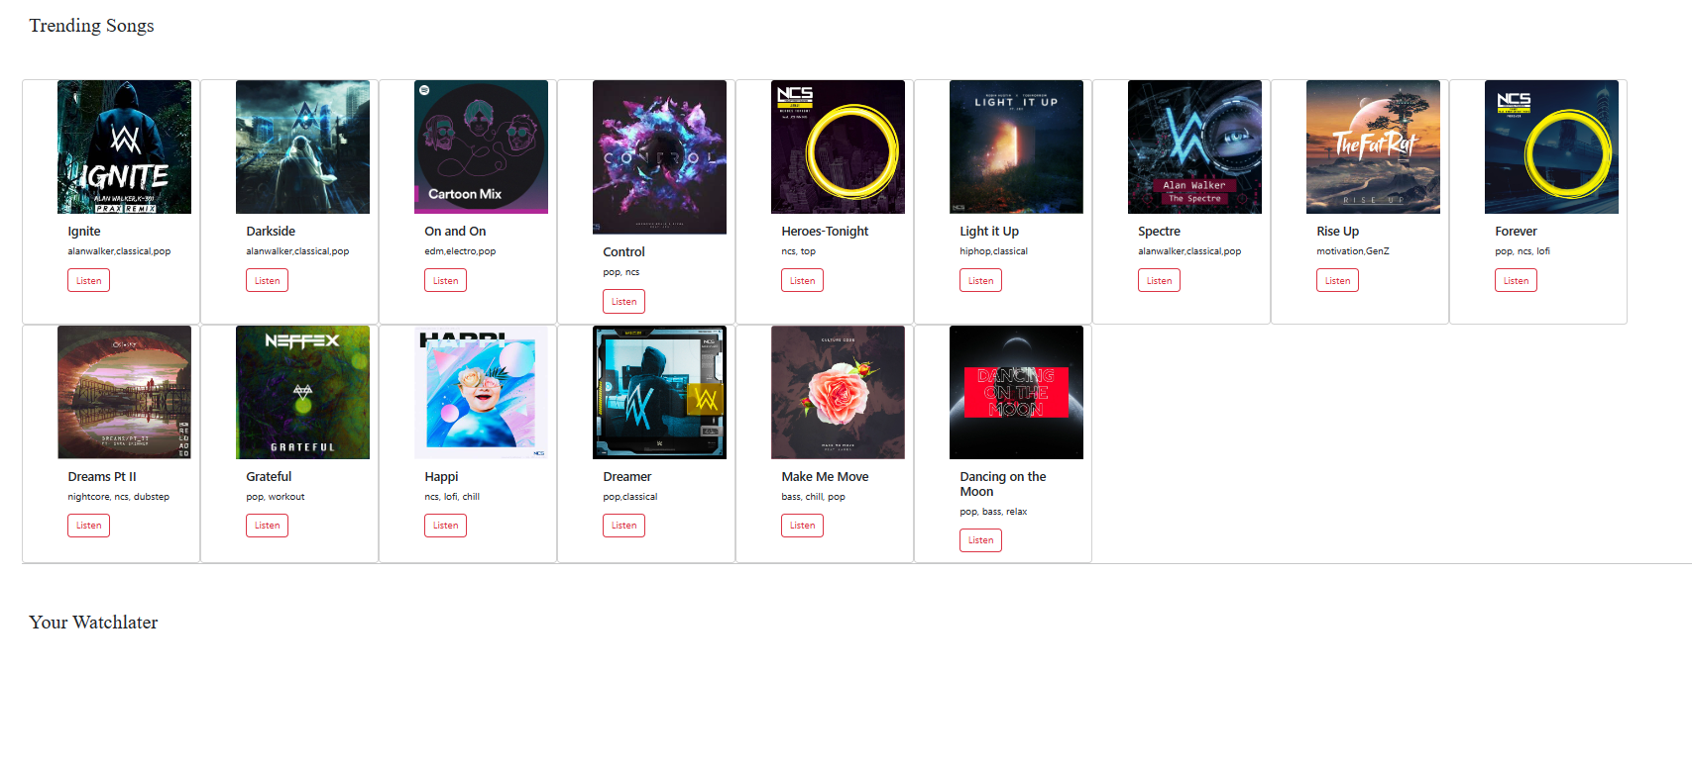
Home Page

Slide 12
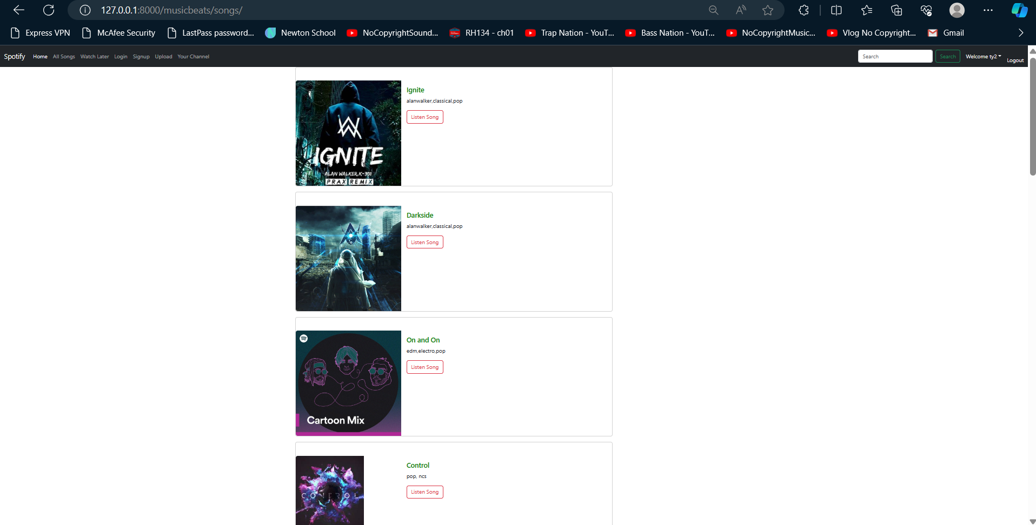
All Songs

Slide 13
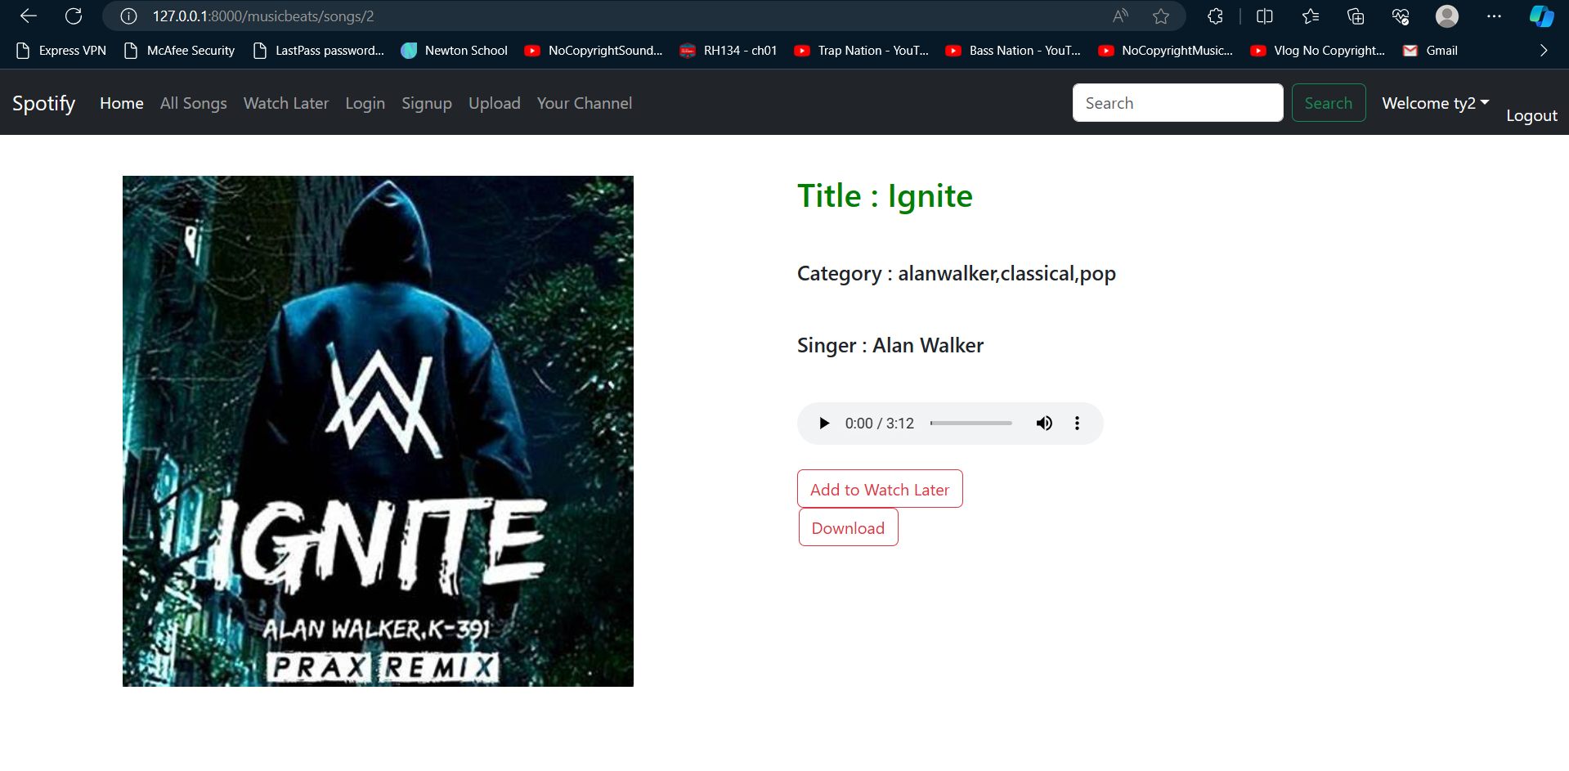
Song Page

Slide 14
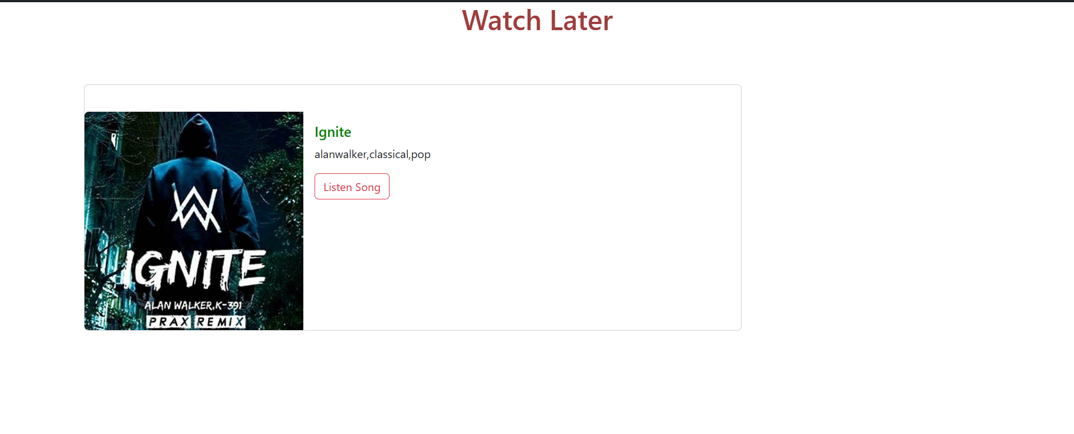
Watch Later

Slide 15
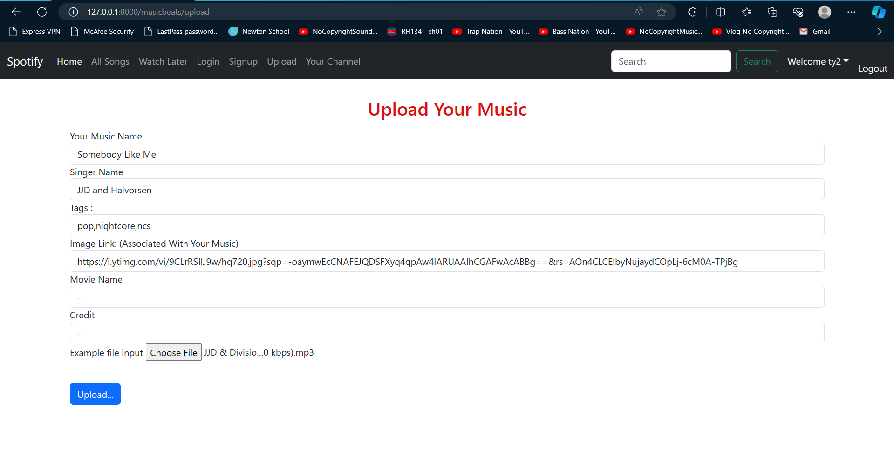
Uploading the Song

Slide 16
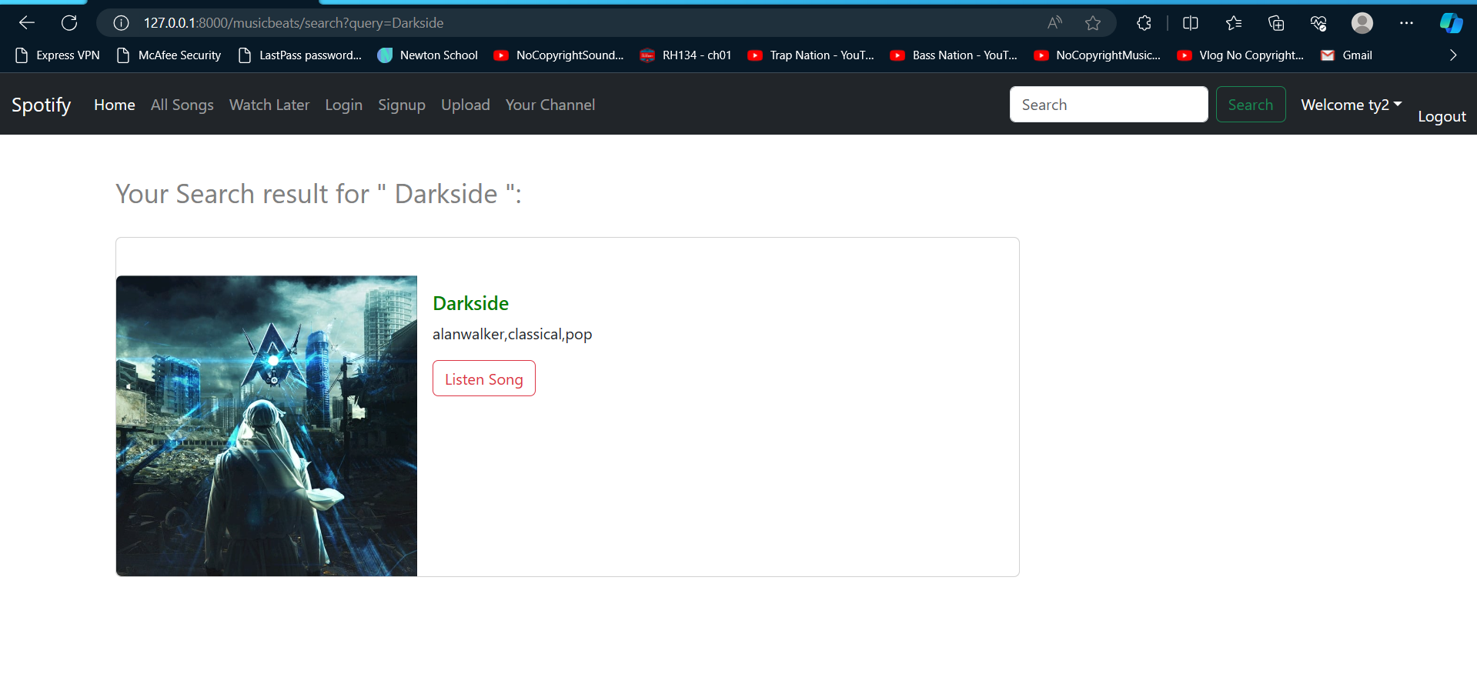
Search Feature
Source :

Slide 17
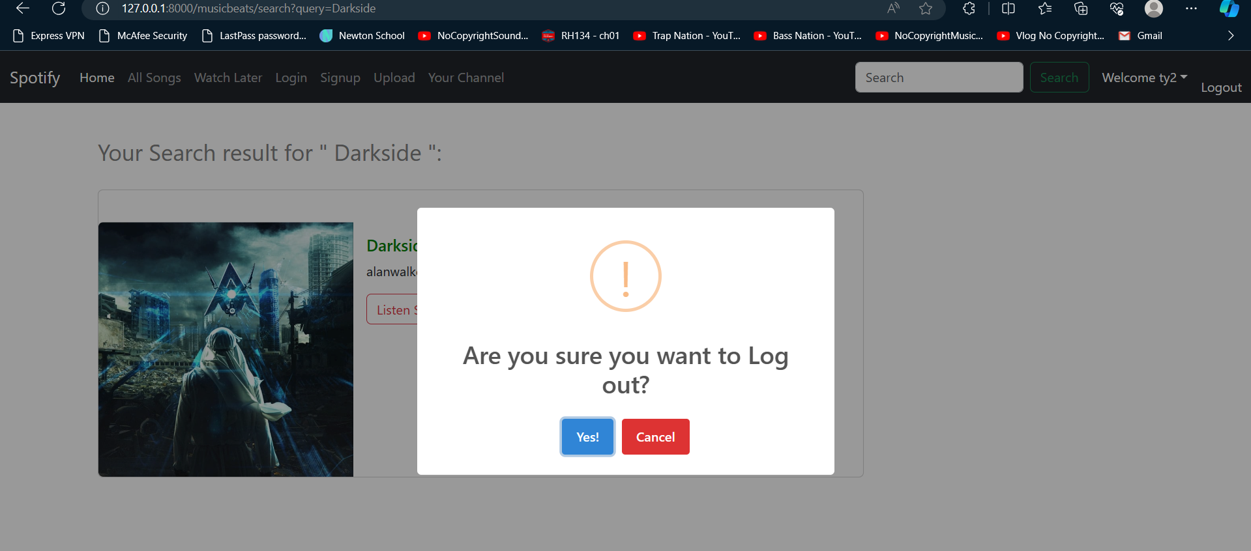
Logout

Slide 18
Conclusion
In conclusion, the development of the music player web application promises to revolutionize how users interact with and enjoy music online. By leveraging modern web technologies and integrating with music streaming services, the application offers a seamless and intuitive platform for accessing a vast library of songs and albums. With features such as playlist management, playback controls, robust search functionality, and user profiles, the application caters to the diverse needs and preferences of music enthusiasts. Moreover, the emphasis on compatibility, usability, and performance ensures a consistent and enjoyable user experience across different devices and platforms. Through rigorous testing and user feedback, the application continues to evolve and improve, aiming to deliver a high-quality music streaming experience that enhances user satisfaction and engagement. Overall, this project represents a significant step forward in providing users with a convenient and personalized way to discover, listen to, and enjoy music online.

Slide 19
Thank You!
Notes:
Thank You !!

